Slide 1

Welcome Let's make your efforts meaningful!
By Starsplusplus

Slide 2
What is significant impact?
How can we help non-profits measure their impact quantitatively and qualitativly?
What tools can we provide to collect and analyze data that reflects the results and effectiveness of non-profit initatives?
How can non-profits make informed decisions based on the data they collect?

Slide 3
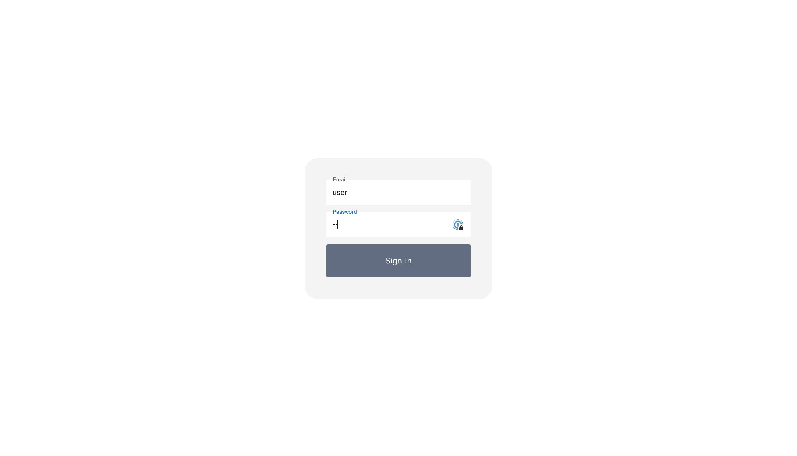
Signifimpact – impact tracker

Slide 4
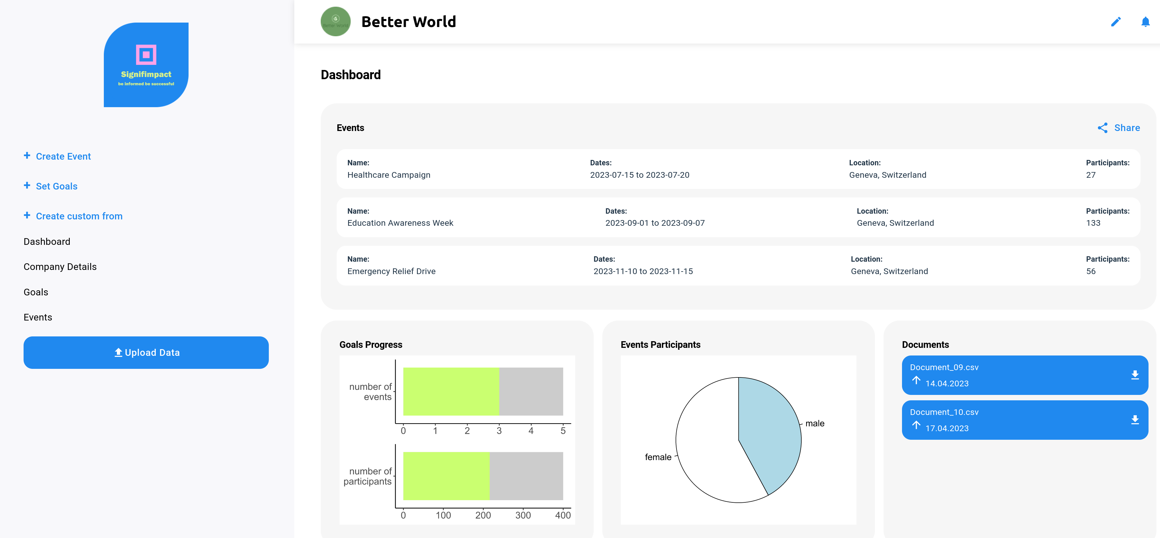
The Dashboard

Slide 5


Highlights
Our stack:
Javascript frontend (React framework)
+
Python backend (FastAPI)
User-friendly interface
Streamline your impact reporting
Data-driven decision making
1
2
3

Slide 6
Coming soon...
User roles: admin, project leader and volunteer 👪
Project Level Reporting 📒
Data Security and Protection 🔐
Dynamic Data Visualization 📊
AI powered Reporting and Analyzing Tools 📃📈
Integration with External Platforms 💻
And even more… 💡📚

Slide 7
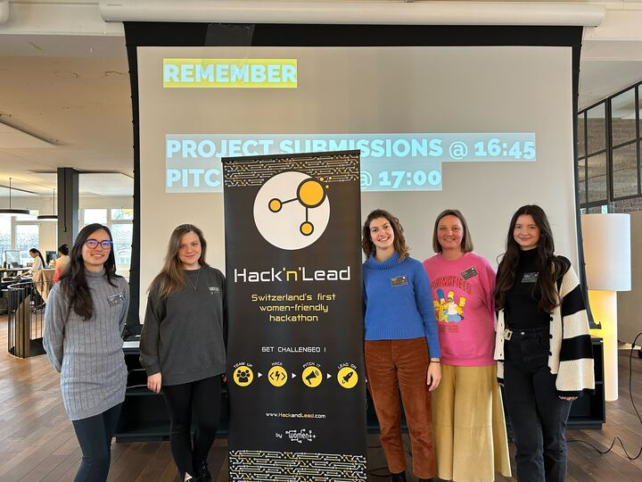
Thank you
The Starsplusplus team

